Slide 1
Tutorial 2
Getting Started II
Tiffany Wun || Fatemeh Rajabiyazdi
twwun@ucalgary.ca || frajabiy@ucalgary.ca
Notes:
Mention email time, and also that a list of links exist at the end of slides
Ask if there are any unclear concepts from last time
SLOW DOWN FAM

Slide 2
TODAY
JS Objects & Anonymous Functions
JQuery and Intro to D3
CSV, JSON, and Loading Data
Hosting your assignments on the CPSC servers

Slide 3
Everything* is an object in Javascript
* Unless they are primitive data types (bool, string, number, null, undefined)**
** Although bools, numbers, and strings can be objects if defined with the new keyword
Notes:
Booleans, numbers, strings can also become objects - if they are defined with the new keyword
Arrays, functions, objects are always objects though

Slide 4
THERE ARE NO CLASSES
Notes:
Rather, you can use object constructors, or object literals

Slide 5

JS OBJECTS
Objects can “simulate class types” with constructor functions
function drink(a, b, c){
this.name = a;
this.price = b;
this.ingredients = c;
}
Object can contain name(property):value pairs
var coffee = new drink(“Black coffee”, 2, “beans”);
You can assign new properties to your objects
coffee.soldOut = false;
Notes:
YOU CAN DEMO THE NEXT TWO SLIDES IF YOU WANT, BUT IT SHOULD BE FINE JUST TALKING ABOUT IT
There are no classes in JS - everything is an object
Objects can “simulate class types” with constructor functions - containing properties and values (also called name:value pairs)
The neat thing in JS is that you can assign new properties to your objects after creation - so if we assign the soldOut property, it will become part of the coffee object

Slide 6
JS OBJECTS
You can create object literals by defining name:value pairs inside {}
var espresso = {
name: “Single Espresso”,
price: 2,
flavour: “bitter”
};
Notes:
Espresso is now defined by an object literal
Beware though that var coffee and var espresso are both of type object << espresso doesn’t have constructor name drink

Slide 7
ANONYMOUS FUNCTIONS
function drink(a, b, c){
this.name = a;
this.price = b;
this.info = function(){
return this.name + ‘ ‘ + this.price;
}
};
Functions without a name
If stored in a variable, they are called using the variable name
Can’t be reused (no name)
These are often used in Javascript, and JS libraries
Useful for when you want to limit their scope
Cleaner when you want to run a small function
Notes:
Anonymous functions:
Functions without a name, and only accessible in that scope
If they are stored in a variable, they are called using the variable name
Make on board a quick example of new object and call object.info
Why do we want anonymous functions though:
They can’t be reused outside of that scope (no name to refer to them)
(functions without names - we don’t want to call it anywhere else so there’s no need to have a name)
If stored in a variable, they are called using the variable name
Good for when you want to run a small function for a single object

Slide 8
this
this refers to the ‘owner’ of the function being executed - it can change
var f = function foo(){
this.bar = false;
}
<body onload = init(this)>
this refers to its parent object when a new f is generated
this refers to the HTML element that invoked it
Notes:
This.bar = false, this will refer to its parent object when a new f object is generated

Slide 9
JQUERY
Javascript library designed to simplify document navigation and selection, make animations, events, and more
Google hosts a collection of JS libraries on: https://developers.google.com/speed/libraries/ - follow the instructions there to load the library
“Write less, do more”
Notes:
JQuery’s purpose -make it easier to write JS
Contains features like HTML/DOM/CSS manipulation, animations, event methods, and more
To load the jQuery library in your webpage, go to the link above and embed the link given

Slide 10
THINGS JQUERY CAN DO
Hide/show HTML elements
Add, modify, and remove HTML elements
Animate HTML elements
Edit CSS Styles
Bind functions to events
...and more
Check the jQuery Documentation!
Notes:
Hide/show HTML elements
Add, modify, and remove HTML elements
Animate HTML elements
Edit CSS Styles
Bind functions to events
...and more

Slide 11
JQUERY vs PLAIN JS
Example:
//vanilla JS
var thisElement = document.getElementById('myDiv');
thisElement.style.display = “none”;
Vs.
//jQuery
$("#myDiv").hide();
$(selector).action();
$ accesses jQuery
selector to find an HTML element(s)
action() is performed on the element
Notes:
Example of hiding a div in plain JS vs jQuery.
Breakdown of a jQuery function: $(selector).action();
$ accesses jQuery
Selector to find an HTML element(or multiple HTML elements)
action() is performed on the element
Selectors are important as that is how your elements are accessed
jQuery (and D3) uses this format

Slide 12
BINDING EVENTS IN JQUERY & ANONYMOUS FUNCTIONS
$(document).ready(function(){
});
We can also declare functions inside other functions, and bind them to event triggers
$(".div1").on(“click”, function(){
$(this).hide();
});
**Anonymous functions**
.on attaches an event handler for “click” to elements of class div1
When the click event is fired, run the function to hide these elements from the screen
this refers to the element in the parent function
NOTE: It is generally good practice to put your jQuery methods into the ready event, so code will only run once your document loads
Notes:
jQuery also gives you control over binding events
We can also declare anonymous functions(remember from earlier) inside actions, and bind them to event triggers
This function will only run in the scope of when the document is ready
.on attaches an event handler for “click” to elements of class div1
When the click event is fired, run the function to hide these elements from the screen
this refers to the element in the parent function
NOTE: It is generally good practice to put your jQuery methods into the ready event, so code will only run once your document loads

Slide 13
D3.js
D3 is a data-driven library for visualizing data with HTML, CSS, and SVG
“D3 allows you to bind arbitrary data to a Document Object Model (DOM), and then apply data-driven transformations to the document.”
Download: https://github.com/d3/d3
Note: If you link directly to the script, you need to run a webserver such as WAMP
Data Driven Documents
Notes:
D3 is a data-driven library for visualizing data with HTML, CSS, and SVG
“D3 allows you to bind arbitrary data to a Document Object Model (DOM), and then apply data-driven transformations to the document.”
Download: https://github.com/d3/d3
Note: If you link directly to the script instead of downloading, you need to run a webserver such as WAMP

Slide 14
D3 & JQUERY - THE DIFFERENCE
D3 and jQuery are both DOM manipulation libraries
D3 is data-driven - you can bind data and interactivity to elements
jQuery: Useful for generalized DOM selection
D3: Useful for data visualization
We will cover D3 in more detail in later tutorials
d3.selectAll("p").style("color", function() { return "hsl(" + Math.random() * 360 + ",100%,50%)"; });
D3 has a similar style for function format
https://stackoverflow.com/questions/13187112/what-is-the-difference-between-d3-and-jquery
Notes:
D3 and jQuery are both DOM manipulation libraries (remember that the DOM is what allows JS to modify HTML/CSS by getting them)
D3 is data-driven - you can bind data and interactivity to elements - earlier with jquery we bound event triggers, now d3
jQuery: Useful for generalized DOM selection
D3: Useful for data visualization
We will cover D3 in more detail in later tutorials

Slide 15
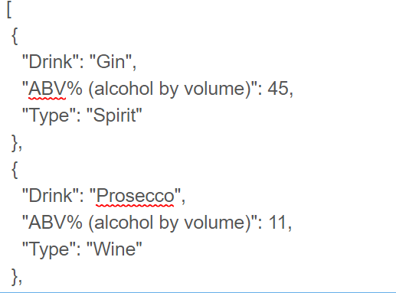
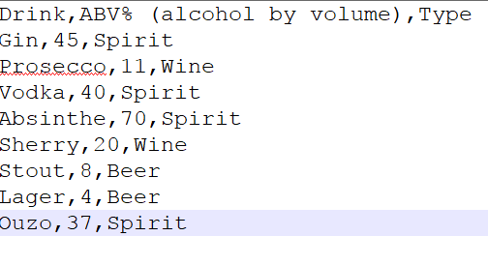
CSV & JSON
CSV (Comma Separated Values)
JSON (JavaScript Object Notation) Format
Notes:
To work with data in JS, we need to parse data into JSON format from a flat data format such as CSV
JSON data can be converted to and from Javascript Objects easily - format is the same as objects with name:value pairs
JSON is easier for humans to read, but on the downside it is more verbose and takes up more size
Access with dot notation or [] brackets

Slide 16
CSV & JSON
JSON Object
Key:Value pair
Accessing values:
X = obj.drink;
X = obj[“drink”];
JSON Format
Notes:
To work with data in JS, we need to parse data into JSON format from a flat data format such as CSV
JSON data can be converted to and from Javascript Objects
JSON is easier to read
JSON objects are by key:value pairs
Access with dot notation or [] brackets

Slide 17
Download T2_Code.zip from Tutorials on D2L

Slide 18
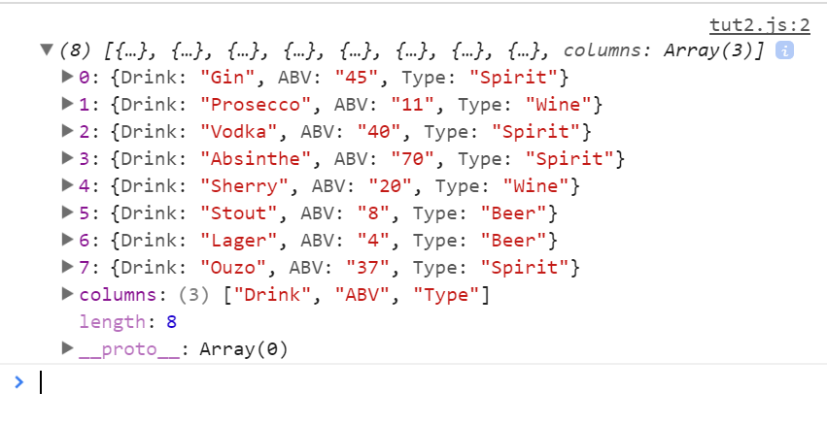
PARSING CSV FILES WITH D3
d3.csv("alcohol.csv",function(data){
console.log(data);
});
data becomes an array of objects
Everything is parsed to strings
Notes:
Output will become this
Note how all the values parsed are strings though
TELL THEM TO TRY THIS

Slide 19
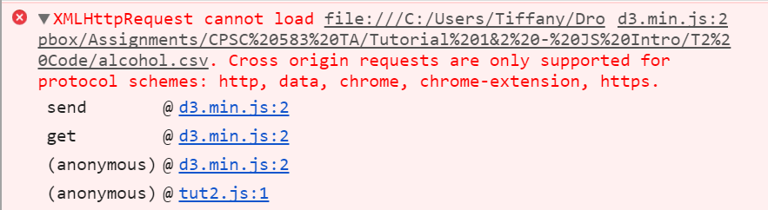
A NOTE BEFORE YOU CONTINUE
For security reasons, Chrome will return an error when trying to load local data over local webpages (URL file://)
You will need to serve the page over HTTPs
https://stackoverflow.com/questions/37781157/d3-csv-show-xmlhttprequest-cannot-load-error
Notes:
It’s not an issue in Firefox

Slide 20
A NOTE BEFORE YOU CONTINUE
Solutions:
Run another browser like Firefox
Webstorm will create a localhost instance when running code in Chrome
Start Chrome with the flag --allow-file-access-from-files
Run a local webserver like WAMP/MAMP. Start the service, place your files in the www/directory, and go to URL localhost
Start a server in Python in the directory of your file:
python -m http.server 8000 (Python 3)
python -m SimpleHTTPServer 8000 (Python 2)
Then go to localhost:8000

Slide 21
DATA FORMATTING WITH D3
d3.csv("alcohol.csv", function(data){
data.forEach(function(d){
d.abv = +d.ABV;
});
console.log(data[0]);
});
+: convert to number
Notes:
Now that we have this csv file, how do we read it in?
D3
Tell what’s happening
For each object in array, Convert ABV values to numbers using + operator
Make a new property in the d object where d.abv would become a number
*CAPS MATTER*
Data is still local to the function though...so how do we make it global

Slide 22
DEMO

Slide 23
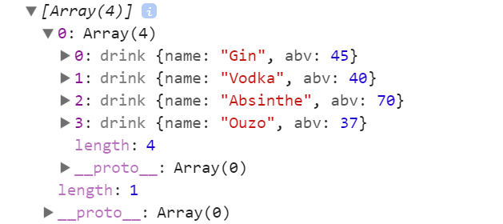
TRY THIS: Add all drinks that are spirits to a global array called spirit_list & print to console (include the name and abv)
Notes:
Give them maybe 7-8 mins or so to figure this out
Final result should look like this pic
Write down stuff on board

Slide 24
Hint: Make a constructor function, also use .push() to append your list
Notes:
After 4-5 mins, or hint by hint

Slide 25
LOADING & FILTERING DATA TO GLOBAL VARS
d3.csv("alcohol.csv", function(data){
data.forEach(function(d){
myDrink = new drink();
if (d.Type === "Spirit"){
myDrink.name = d.Drink;
myDrink.abv = +d.ABV;
spirit_list.push(myDrink);
};
});
console.log(spirit_list);
});
Declare a new drink() object. If the drink is a spirit, assign the object values from the csv, and push it to spirit_list
Notes:
DEMO THIS & SHOW RESULT IN CONSOLE
Give them a few mins to show the solution
For each object in the data array:
Declare a new drink() object. If the drink is a spirit, assign the object values from the csv, and push it to spirit_list
You will now get a global list of your parsed and filtered objects from a csv

Slide 26
SUBMITTING YOUR ASSIGNMENT
Zip up your source code and submit it with your other requirements in D2L’s Dropbox
You must also have a live version of your code running that we can access
Students can publish their webpages on the CPSC servers

Slide 27
HOSTING WEBPAGES ON THE CPSC SERVERS
SSH into the CPSC servers (can use SSH client, Filezilla, etc)
File protocol: SFTP
Host name: linux.cpsc.ucalgary.ca
Port number: 22
2. If there isn’t a www file set up yet in your home directory
mkdir ~/www
chmod 711 ~/www
In www:
Directories should have permission 755 (rwxr-xr-x)
Files should have permission 644 (rw-r--r--)
Otherwise you will get permission errors.
Notes:
Can demo this if you want
All directories in www should have permission 755 (need to be readable & executable by all), and all files (js/html/etc) in www should have permission 644 (readable by all, readable & writeable for author), otherwise you will get permission errors when you try and go to the webpages.

Slide 28
HOSTING WEBPAGES ON THE CPSC SERVERS
Recursively change all directories to 755 (drwxr-xr-x):
find /home/grads/twwun/www -type d -exec chmod 755 {} \;
Recursively change all files to 644 (-rw-r--r--):
find /home/grads/twwun/www -type f -exec chmod 644 {} \;
https://stackoverflow.com/questions/3740152/how-do-i-set-chmod-for-a-folder-and-all-of-its-subfolders-and-files-in-linux-ubu

Slide 29
USEFUL LINKS
https://www.ucalgary.ca/cpsc/tech/services/www
Instructions on how to set up your webpage
http://permissions-calculator.org/
Linux permissions calculator

